Slide 1
HU Resumé Critique
Ever wished of an app which could give a feedback on your resume´ ? Well, wish no more...

Slide 2
We have made a web application which gives feedback based on the user’s input on different fields like: Info, education, achievements and Projects

Slide 3
The application makes the following assumptions to decide the final resume´ points
Since GPA is one of the important components of the resume´, the application will deduct certain points if the GPA is less than 3.5.
The achievement section in the Resume´should be quantifiable. Meaning, if the resume´doesn’t specify the value in terms of number (profit brought in by the employee), the application will deduct certain resume´points.
The application will also deduct certain points if the achievements section doesn’t define a metric in terms of percentage.
If an user doesn’t have anything written under projects section, the application will deduct certain points, because projects are a great source to demonstrate skills to your prospective employers.
If the word count under projects are less than 100 words, the application will make assumption that the experience of the user is not that much. In this case as well, the application will reduce a certain points off the resume.

Slide 4
The final point will be calculated based on our grading metrics mentioned in slide 3. The application will also give detailed reason for the score so that the user can improve his/ her resume´accordingly.

Slide 5
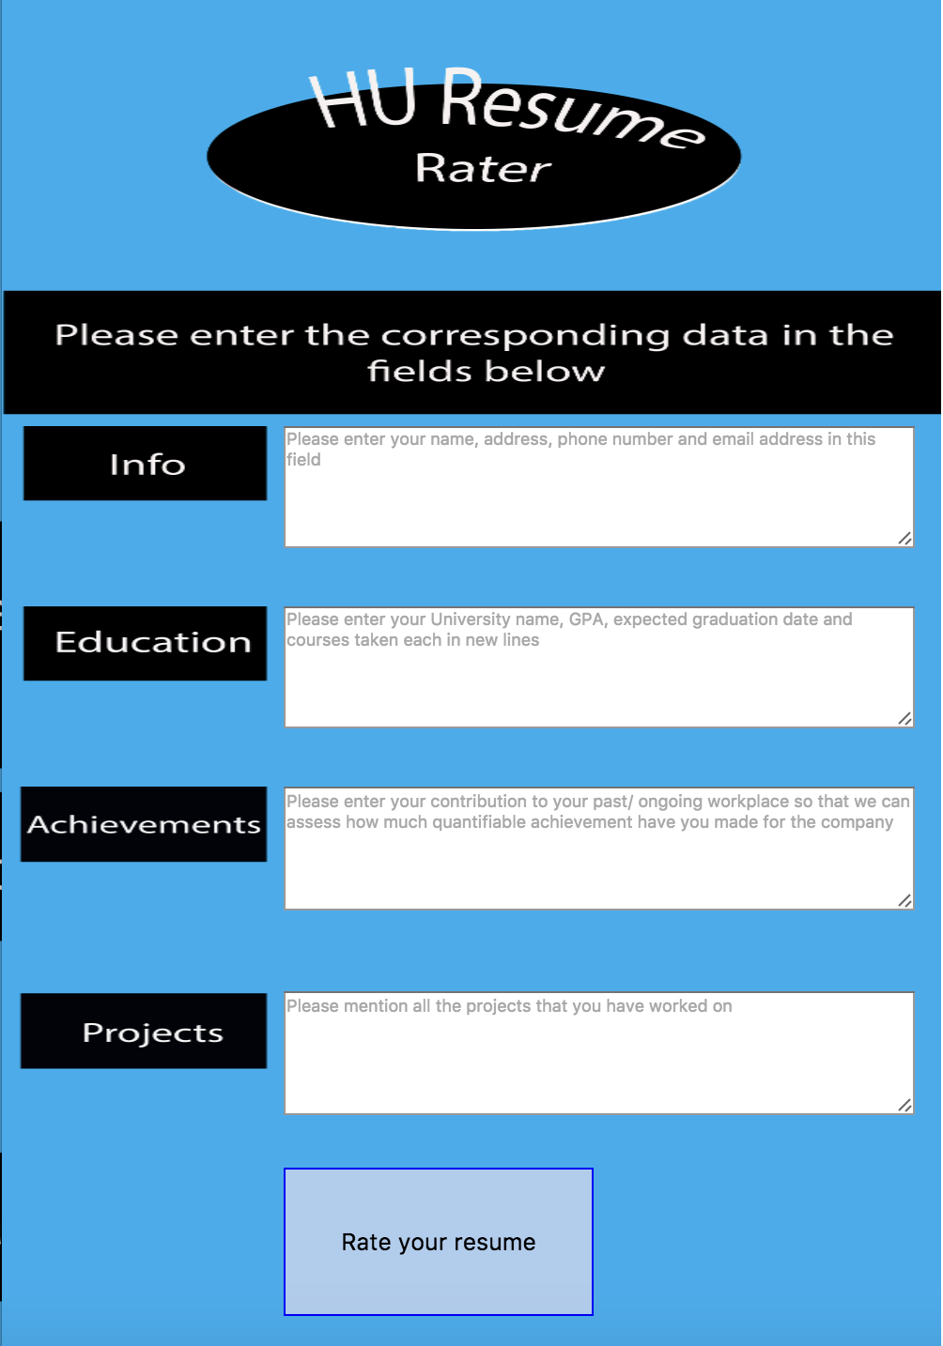
Home page/ UI:

Slide 6
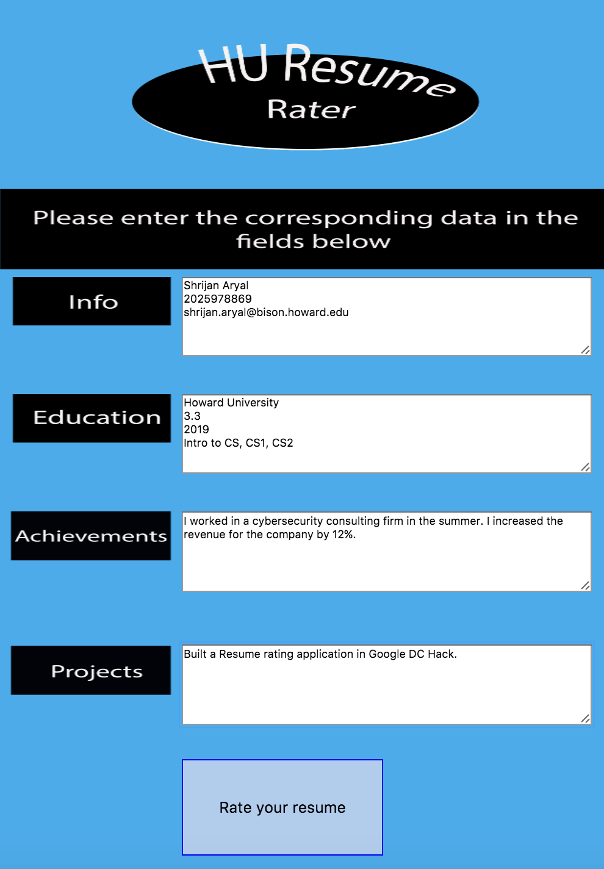
After data is filled:

Slide 7
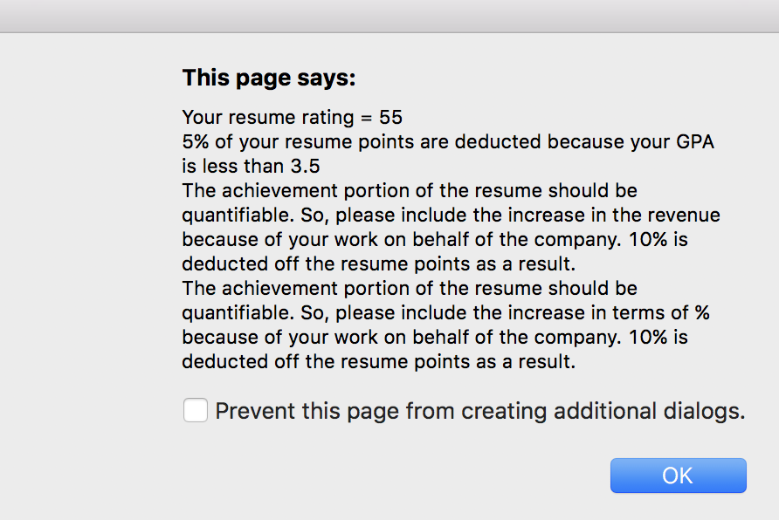
Resume review:

